Slide 1
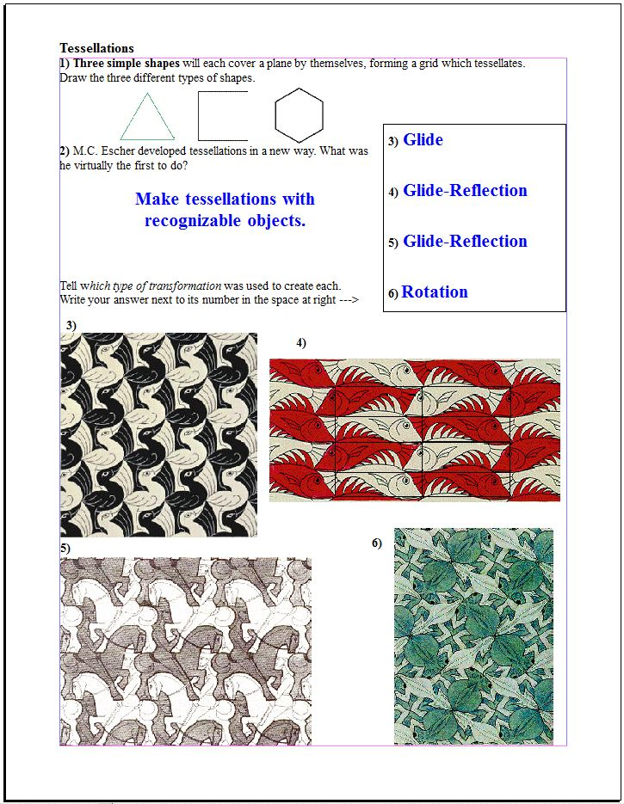
3
1 each
3 each
3
Michael S. Schneider
www.constructingtheuniverse.com

Slide 2
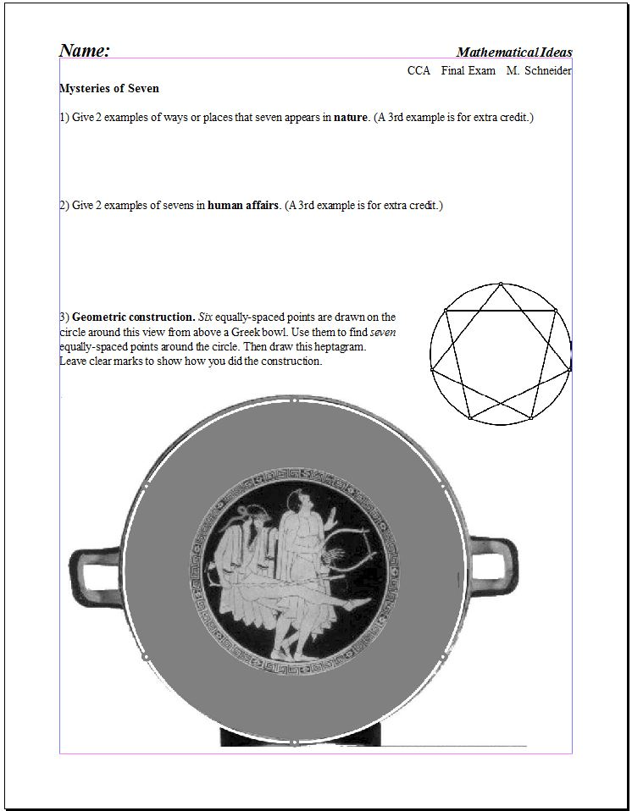
3 each
3 each
12
9 for heptagram construction
3 for Accuracy

Slide 3
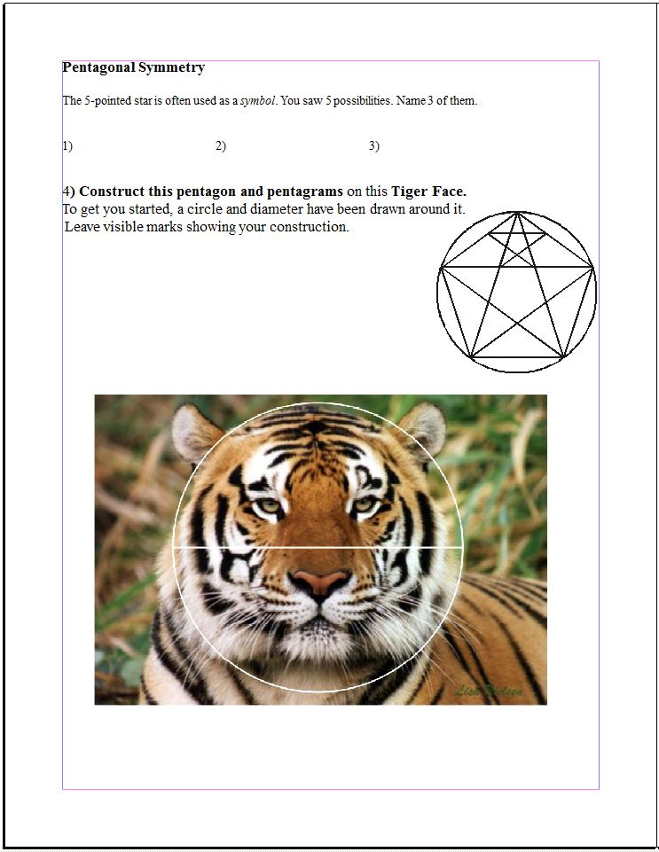
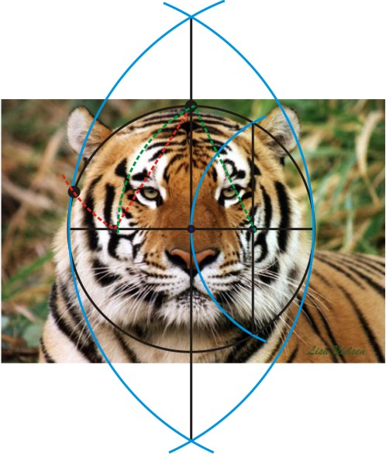
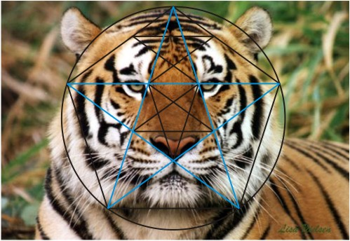
3 each
Life, Regeneration, Humanness, Excellence, Righteous Authority
12
4 points for Almond
5 for pentagon constructions
3 for Accuracy

Slide 4
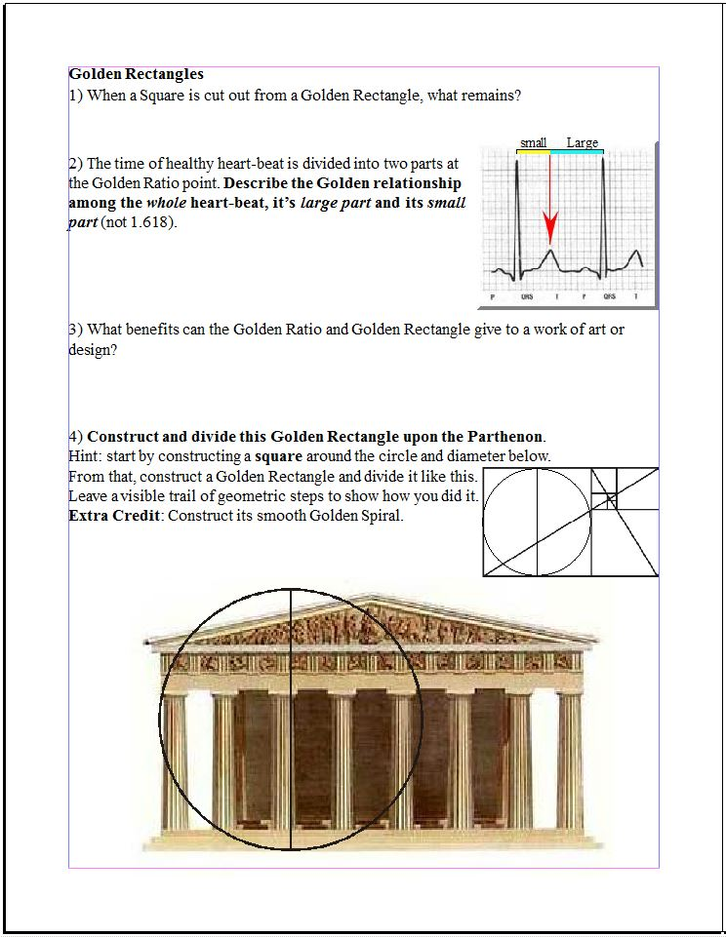
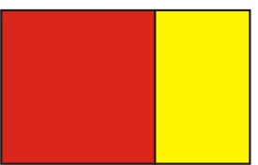
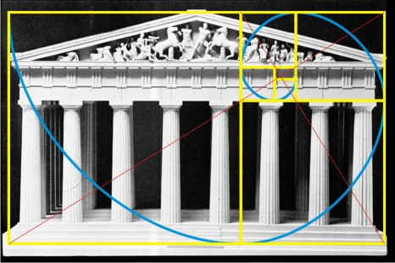
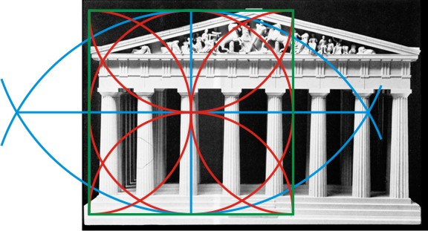
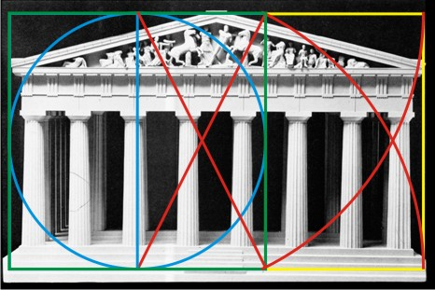
4
A small Golden Rectangle
4
Whole
Large part
Large part
Small part
=
4
Visual harmony, balance, sense of beauty, focus at the spiral’s eye, etc…
4 for Almond, 5 to construct square, 2 construct GR, 4 whirling squares, +2 spiral extra credit
15

Slide 5
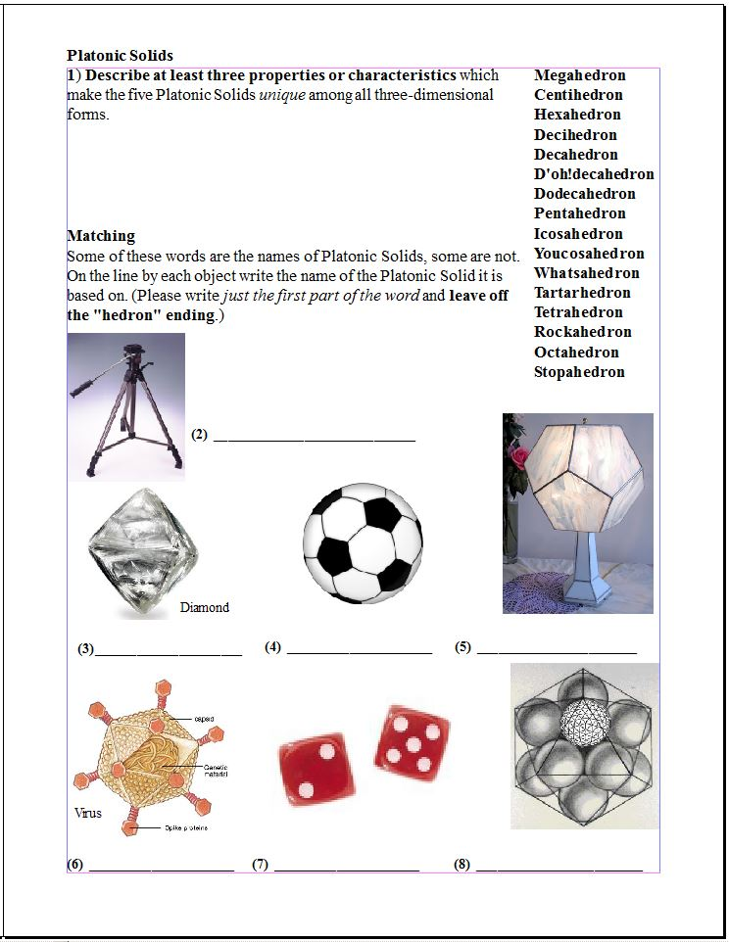
4
Equal angles, equal edge lengths, same faces, equal distance from corners to center
3 each
Tetra
Octa
Dodeca
Dodeca
Icosa
Hexa
Icosa

